Slide 1
Watchdog
Aarti Thapar
Josh Terry

Slide 2
Persona 1: Emily the Accountant
Age: 28
Location: Atlanta, Georgia
Status: Single
Quote:
“I want to be able to know the well-being of my 6 month old Labrador puppy Bruno at home, without having to make several calls to my dog-sitter at home, in between my meetings. Often, I don’t have time to make these calls and it seems very unprofessional if I have to make calls during my meetings.”

Slide 3
Persona 2: James the Undergraduate
Age: 19
Location: Atlanta, Georgia
Status: Single
Quote:
“I am taking 19 credit hours this semester at Georgia Tech along with research, which requires me to spend several hours in the lab and also in classes. I have a twelve year old husky named Romeo who lives with me at my apartment on campus. Romeo is of age now and often suffers through certain breathing problems due to age. There is no one else to take care of Romeo as my parents live far away in Texas. I would like to be there to take care of Romeo all the time but my schedule does not allow me to be back to my apartment before 9 pm on weekdays. Fortunately, I live on-campus so it does not take me a long time to go back to my apartment from my classes and research lab. I would like to have a way that would specifically let me know if Romeo is going through any breathing problems whilst I am in class or in research.”

Slide 4
User Stories - Some Examples
As a dog owner, I want to be notified when my dog falls asleep and wakes up so that I can be better aware of its behavior when I am away.
As a dog owner , I want to be notified when my dog is stressed so that I am aware that my dog is stressed and can do something about it.
As a dog owner, I want to be notified when my dog has eaten food so that I can keep a count of the number of meals my dog has eaten during the day.
As a dog owner, I want the wearable device for myself to be lightweight or wireless so that it is comfortable for me to use/ wear.
As a dog owner, i want certain notifications to hold more priority over others so that I make sure that I am aware of these notifications.

Slide 5
Use scenarios
Scenario 1: Stella’s Dog is stressed
Stella’s dog is stressed out because of thunder outside.
Stella’s dog collar detects that the dog is stressed out.
The collar sends a notification to Stella’s wearable device that the dog is stressed out.
Audio (in the form of a notification) is played on Stella’s wearable device that alerts her that her dog is stressed.
Audio is played via the dog’s wearable collar that is supposed to calm the dog.
Scenario 2: Stella wants to hear about the surroundings of her dog.
Stella is at lunch break during work.
Stella wants to hear about the surroundings of her dog.
She selects the “Hear surroundings” option on her wearable device.
Live recorded audio from the wearable collar is played via the wearable device to Stella.
Stella can now hear surroundings and choose to stop hearing the surroundings by selecting the “Stop” option on her wearable device.

Slide 6
Sound Effects
Event Sound Effect Index
Too hot Sizzling/popping hotter = intensity, pitch increase
Too cold Ice crunching colder = intensity, pitch decrease
Falls asleep Dog snoring Fades in and out slowly
Wakes up Rooster crowing Fades in quickly and out slowly
Dog barking Microphone feedback Normalize volume to not alarm user
Any notification Ping sound effect Intensity scales with importance

Slide 7
User Study on Sound Effects
Event Sound Effect User Impressions
Too hot Sizzling/popping “It sounds like something cooking”
Too cold Ice crunching Winced, but could tell it was ice crunching.
Falls asleep Dog snoring “The dog fell asleep?”
Wakes up Rooster crowing “The dog woke up?”
Dog barking Microphone feedback “Why is the dog yelling at me”
Any notification Ping sound effect Louder + more beeps = more important.

Slide 8
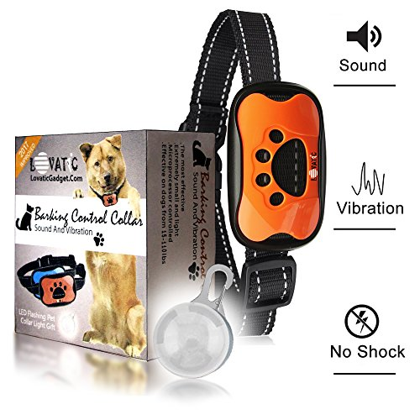
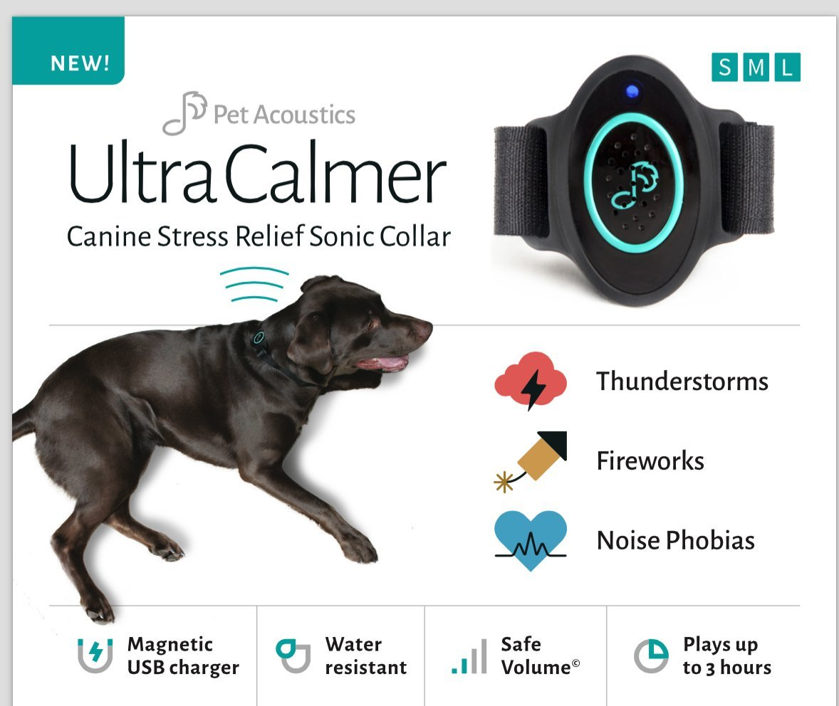
Hardware: Collar
Pull from existing shock/calming collar designs
Lovatic anti-bark collar
Pet Acoustics UltraCalmer
Implement clear affordances
Non-threatening, comfortable design

Slide 9
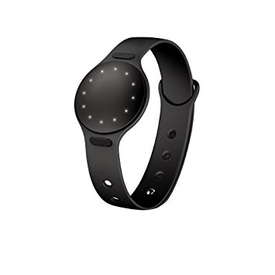
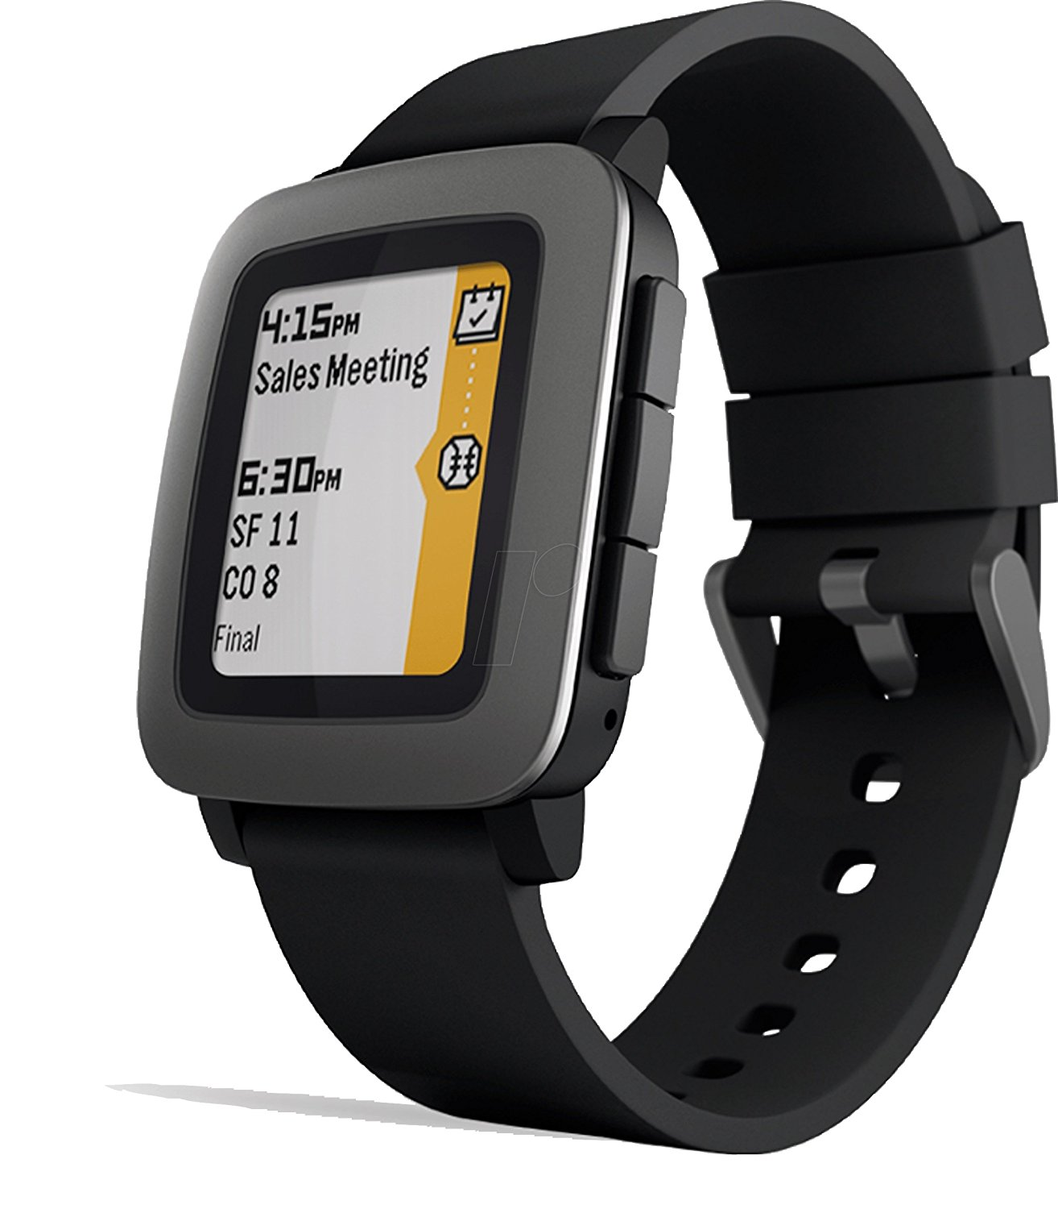
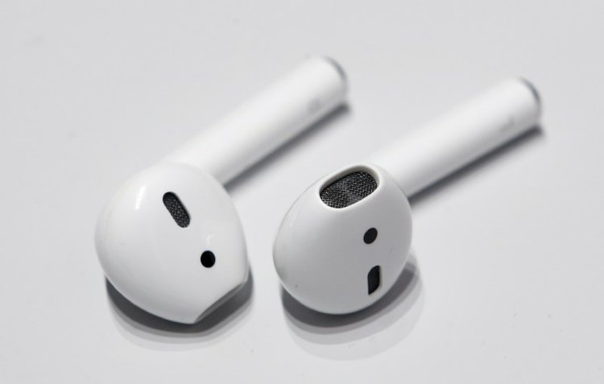
Hardware: User Wearables
Pull from existing smart watch/in-ear monitor designs
Misfit Shine
Pebble Time
Apple Airpod
Familiar, comfortable hardware that is easy to understand and use
Non-invasive, non-threatening design

Slide 10
//TODO:
Perform more user studies with more refined iterations of system sounds
Do further research on ways to better take advantage of auditory input and interactions
Do further research on means of immediately sonifying data in a more streamlined manner
Finalize hardware, software, and experience designs of product

